Slide 1
MAC Protocols
Dr. R. Prashanth

Slide 2
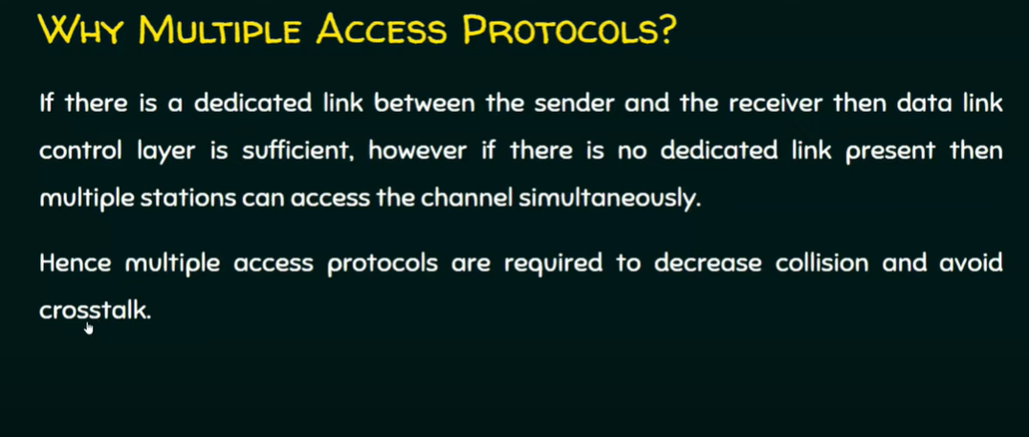

Slide 3
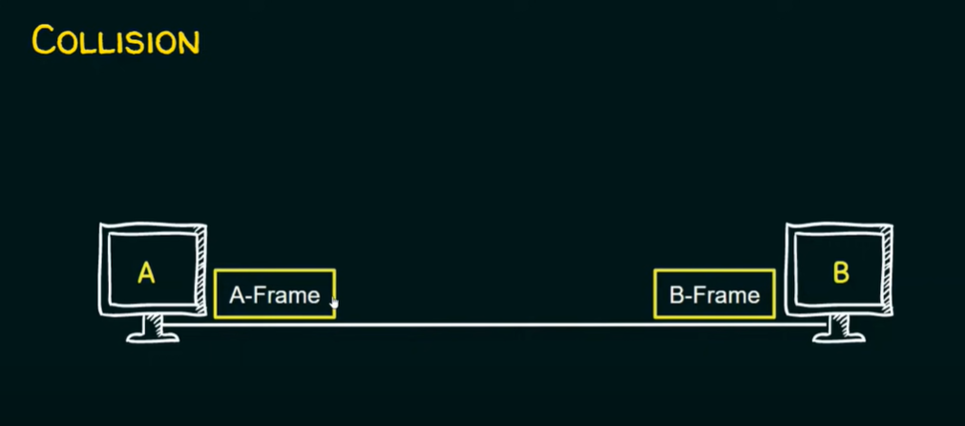

Slide 4
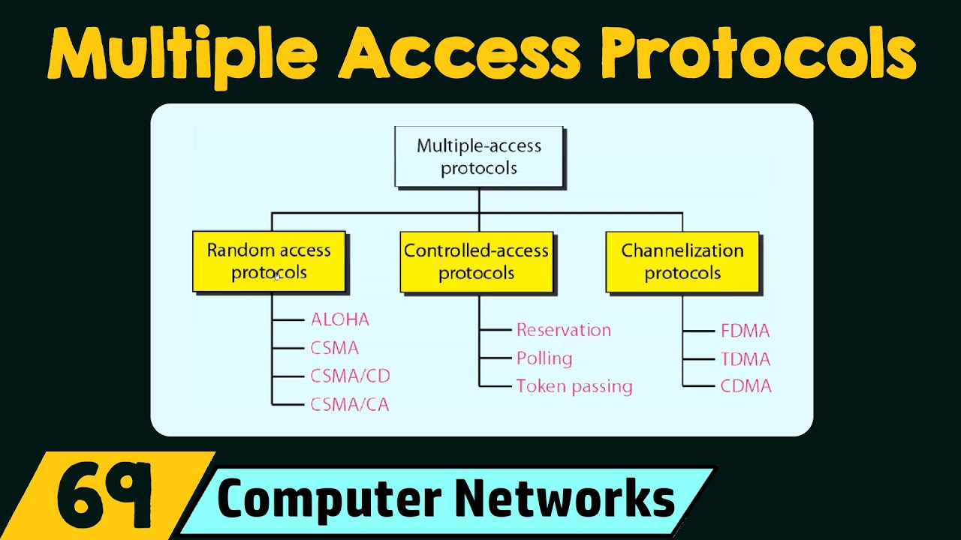

Slide 5
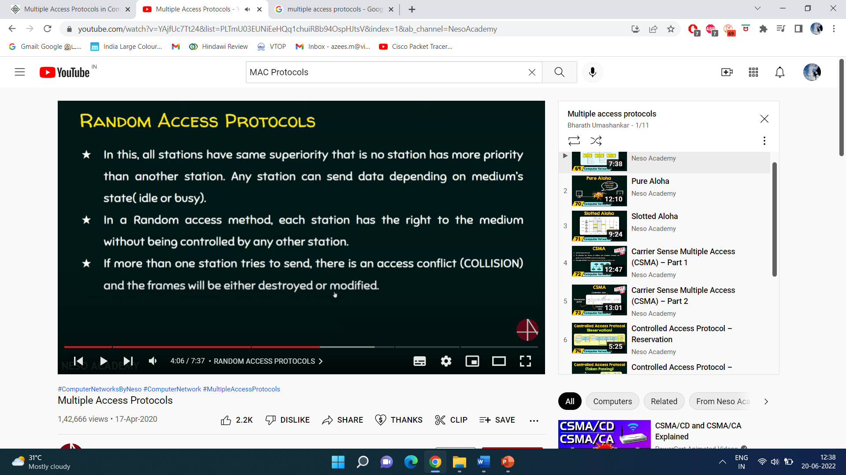

Slide 6
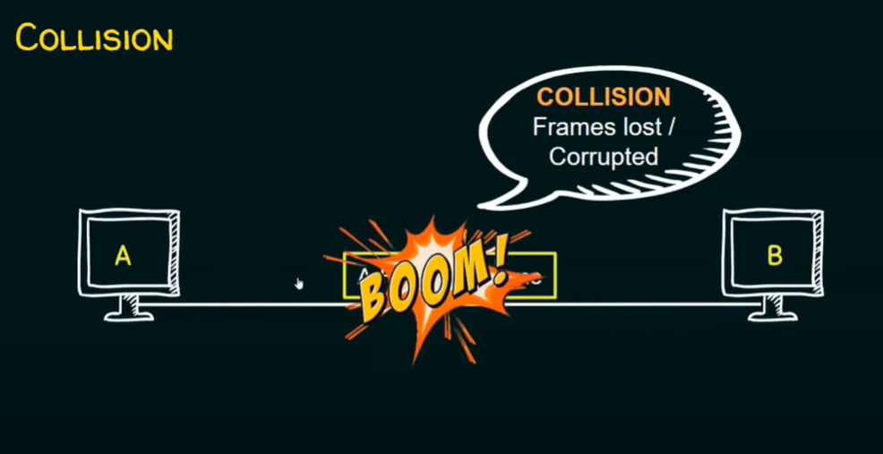

Slide 7
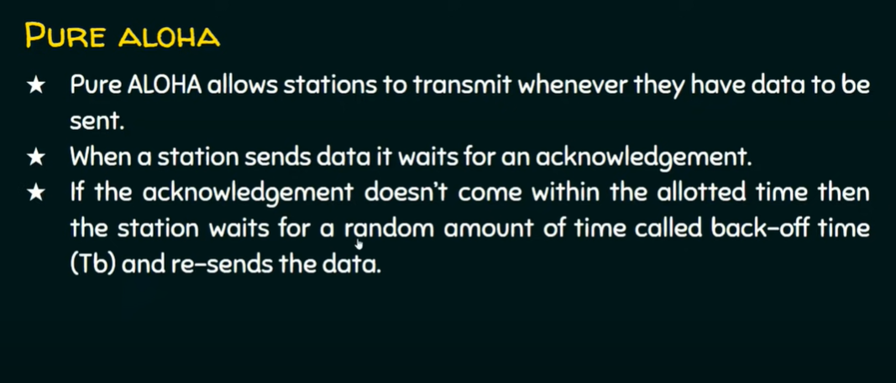

Slide 8
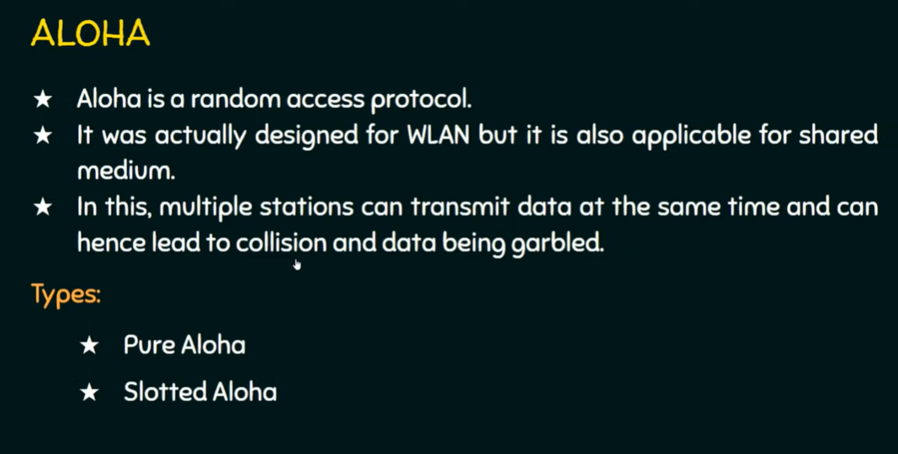

Slide 9
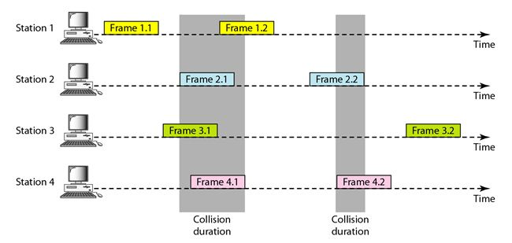
Pure Aloha

Slide 10
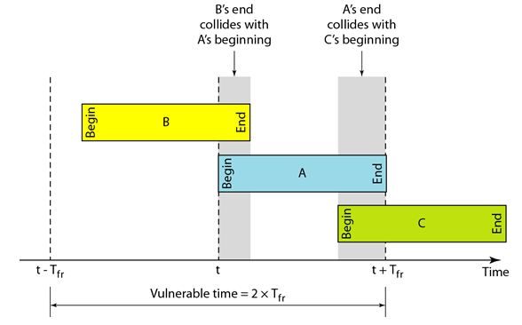
Pure Aloha Vulnerable time

Slide 11
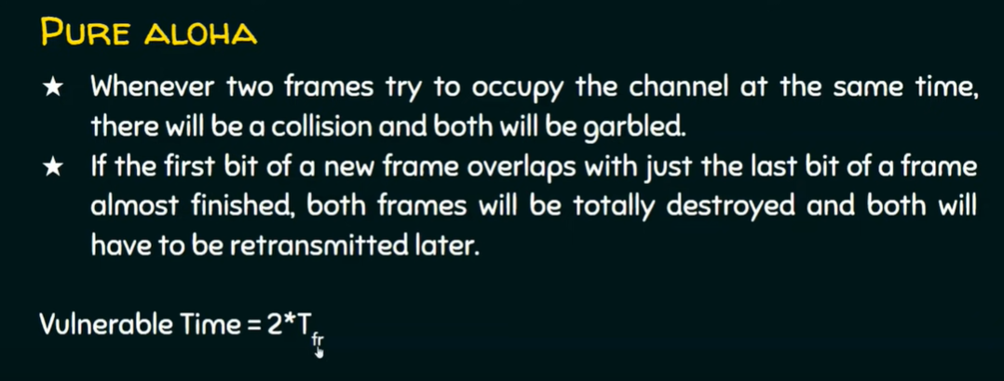

Slide 12
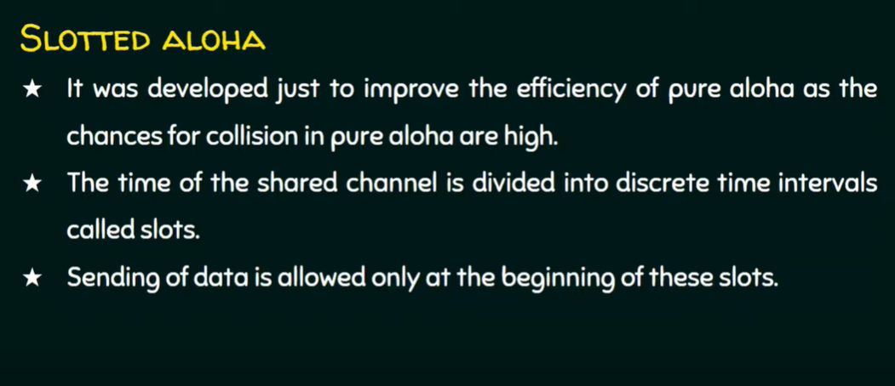

Slide 13
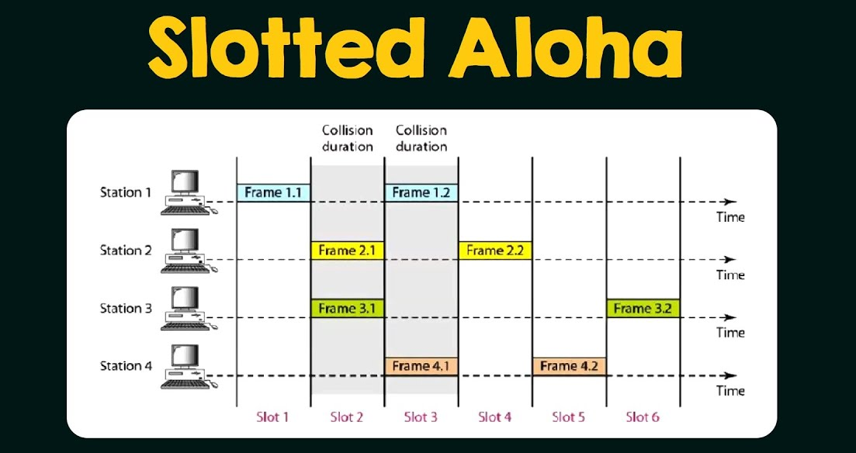

Slide 14
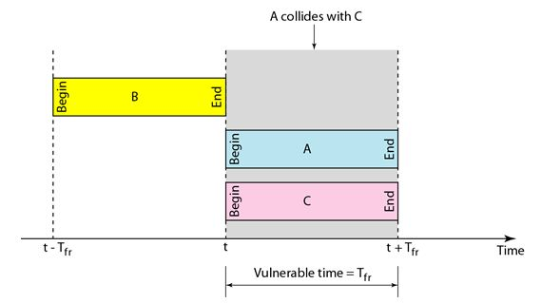
Slotted Aloha Vulnerable time

Slide 15
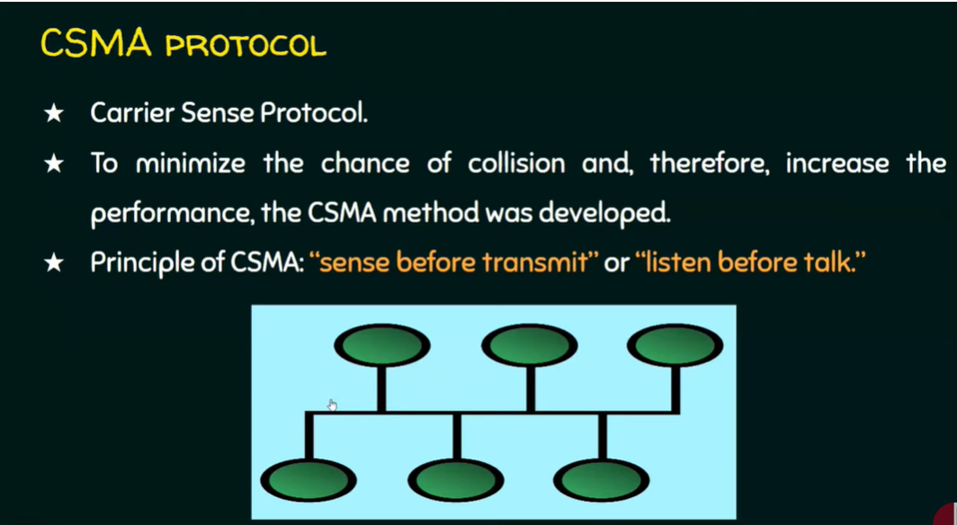

Slide 16
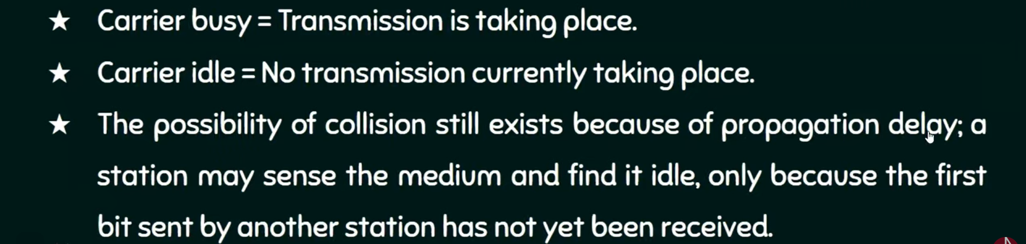

Slide 17
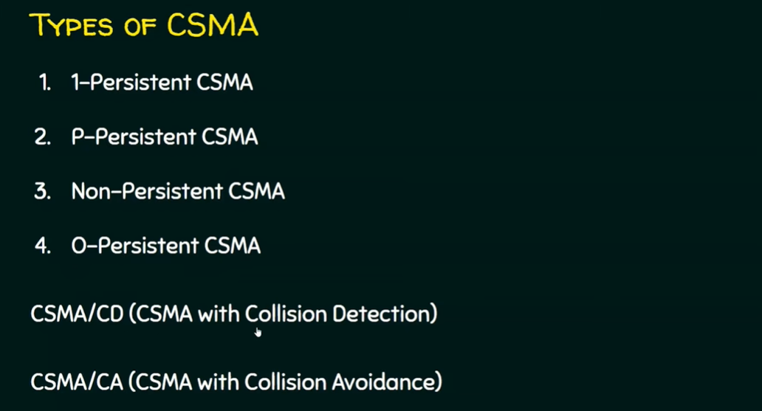

Slide 18
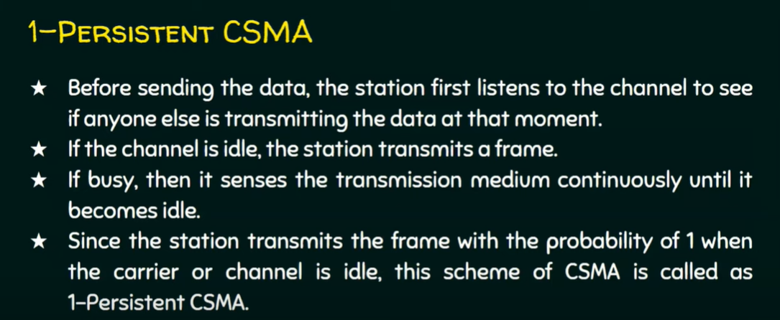

Slide 19
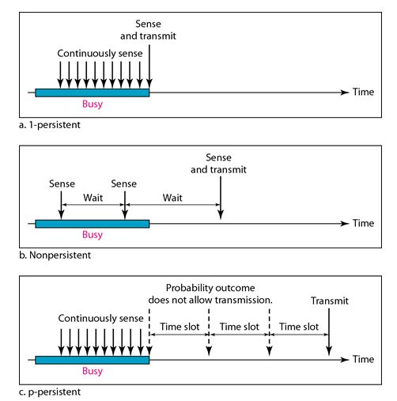

Slide 20
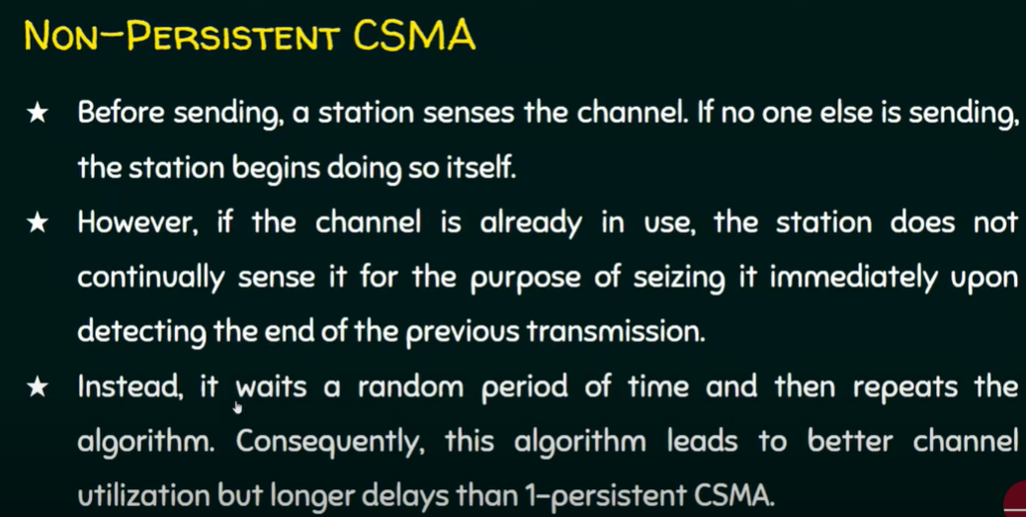

Slide 22
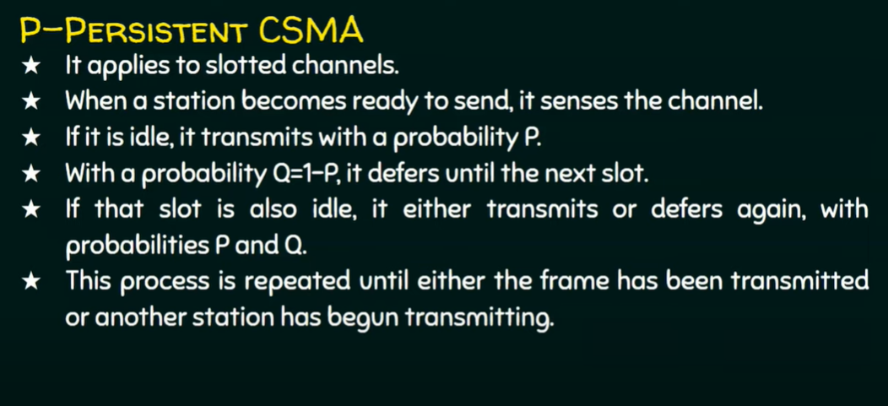

Slide 24
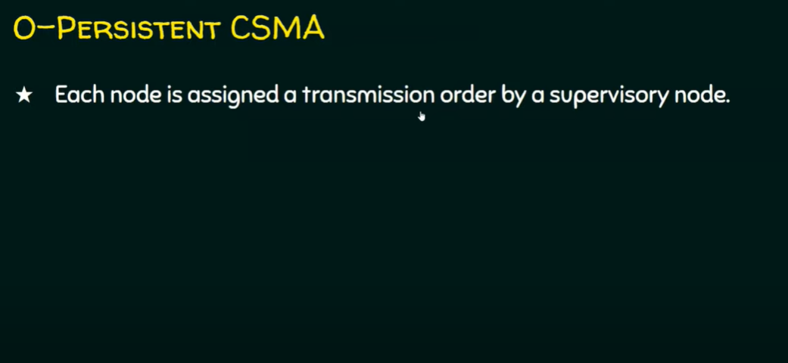

Slide 25
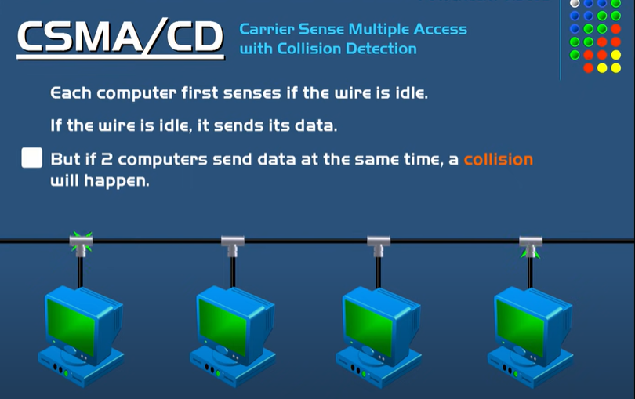

Slide 26
CSMA/CD (Carrier Sense Multiple Access/ Collision Detection) is a media access control method that was widely used in Early Ethernet technology/LANs when there used to be shared Bus Topology and each node ( Computers) were connected By Coaxial Cables.
Working procedure
Step 1: Check if the sender is ready for transmitting data packets.
Step 2: Check if the transmission link is idle. Sender has to keep on checking if the transmission link/medium is idle. For this, it continuously senses transmissions from other nodes. Sender sends dummy data on the link. If it does not receive any collision signal, this means the link is idle at the moment. If it senses that the carrier is free and there are no collisions, it sends the data. Otherwise, it refrains from sending data.
Step 3: Transmit the data & check for collisions. Sender transmits its data on the link. CSMA/CD does not use an ‘acknowledgment’ system. It checks for successful and unsuccessful transmissions through collision signals. During transmission, if a collision signal is received by the node, transmission is stopped. The station then transmits a jam signal onto the link and waits for random time intervals before it resends the frame. After some random time, it again attempts to transfer the data and repeats the above process.
Step 4: If no collision was detected in propagation, the sender completes its frame transmission and resets the counters.

Slide 27
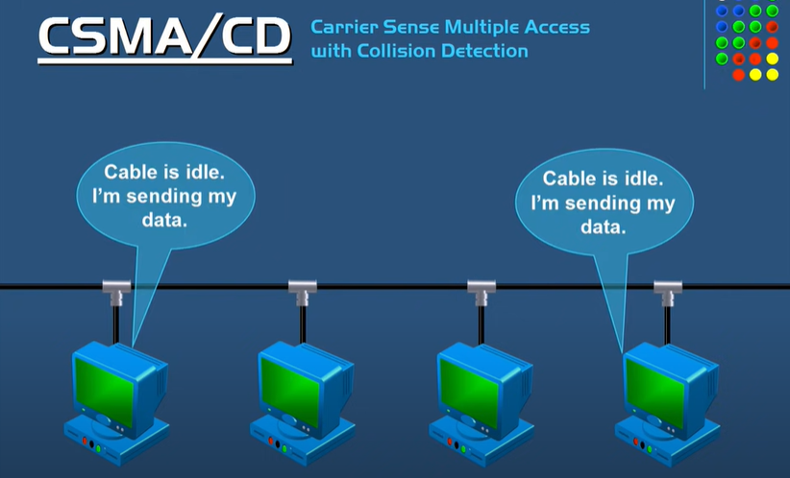

Slide 28


Slide 29
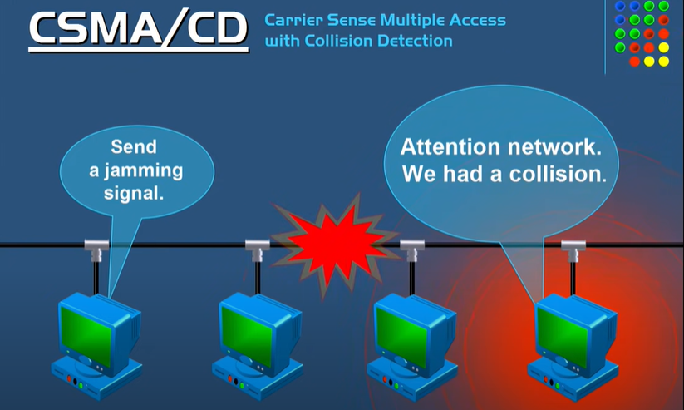

Slide 30
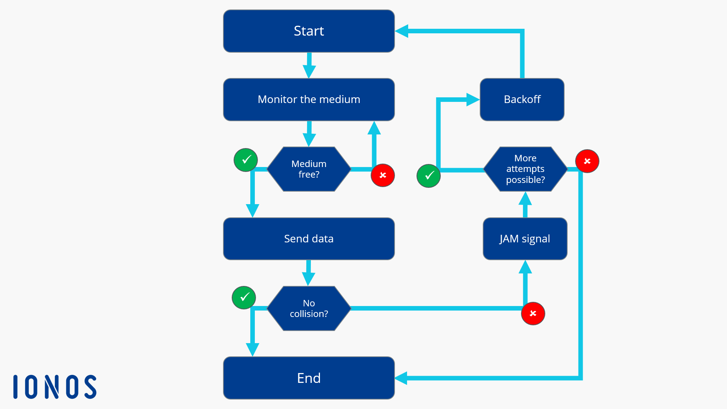

Slide 31
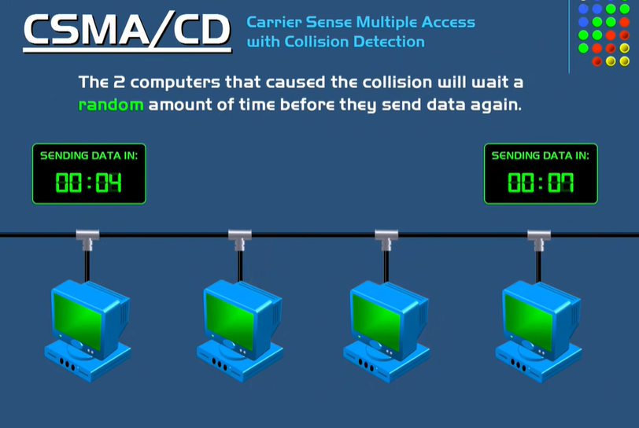

Slide 32
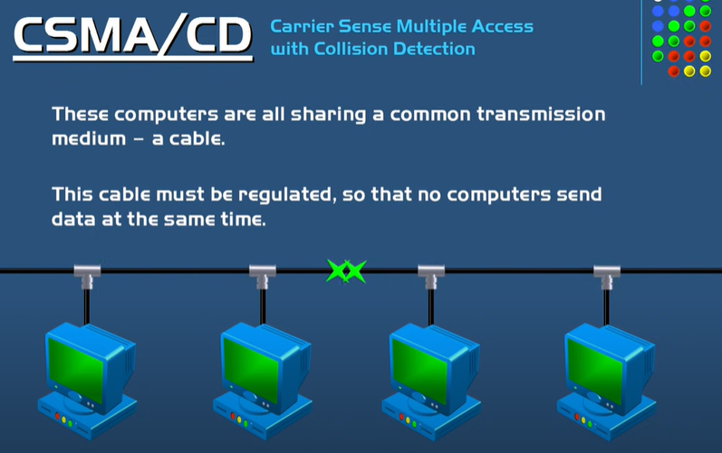

Slide 33
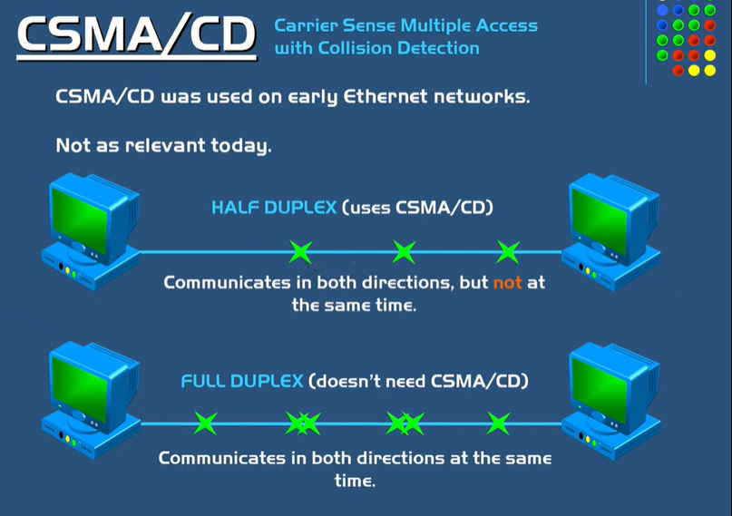

Slide 34
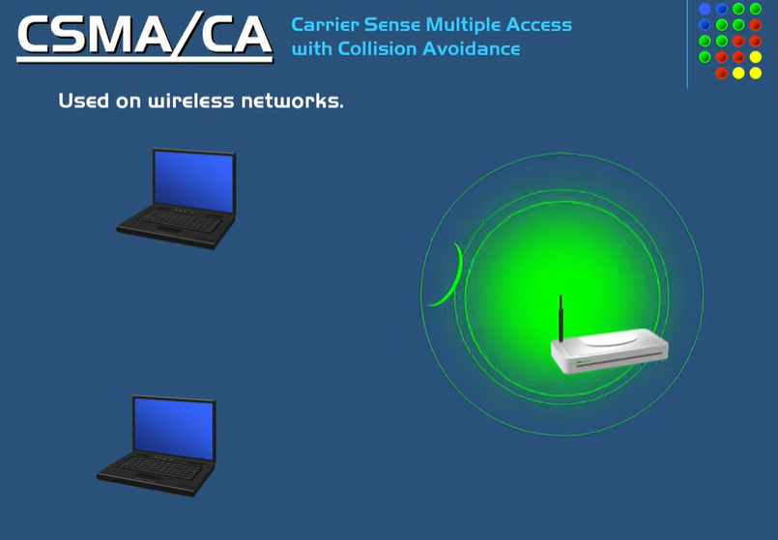

Slide 35
Carrier Sense Multiple Access with Collision Avoidance (CSMA/CA) is a network protocol for carrier transmission that operates in the Medium Access Control (MAC) layer. In contrast to CSMA/CD (Carrier Sense Multiple Access/Collision Detection) that deals with collisions after their occurrence, CSMA/CA prevents collisions prior to their occurrence.
Working Procedure
When a frame is ready, the transmitting station checks whether the channel is idle or busy.
If the channel is busy, the station waits until the channel becomes idle.
If the channel is idle, the station waits for an Inter-frame gap (IFG) amount of time and then sends the frame.
After sending the frame, it sets a timer.
The station then waits for acknowledgement from the receiver. If it receives the acknowledgement before expiry of timer, it marks a successful transmission.
Otherwise, it waits for a back-off time period and restarts the algorithm.

Slide 36
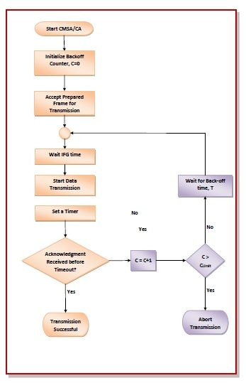

Slide 37
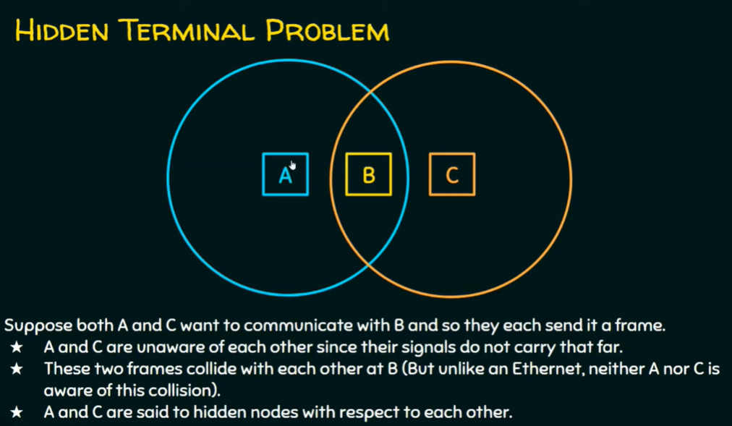

Slide 38
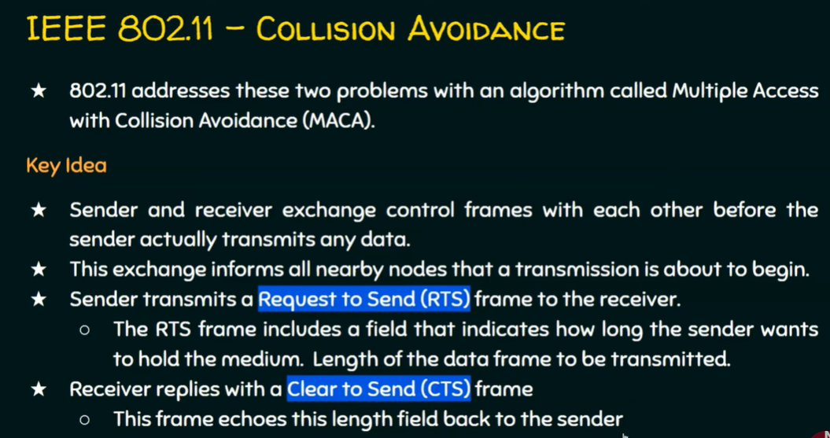

Slide 39
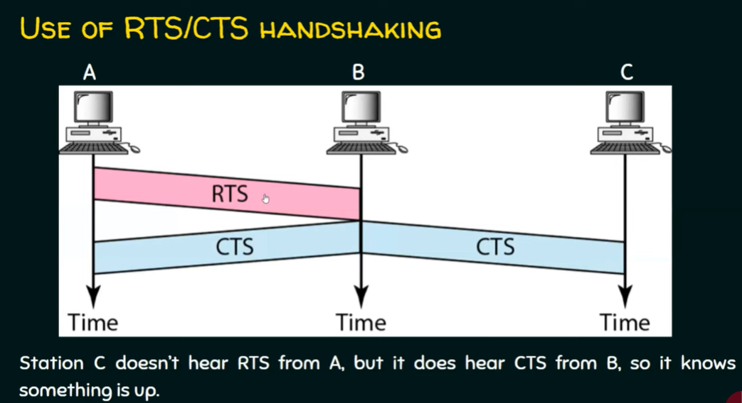

Slide 40
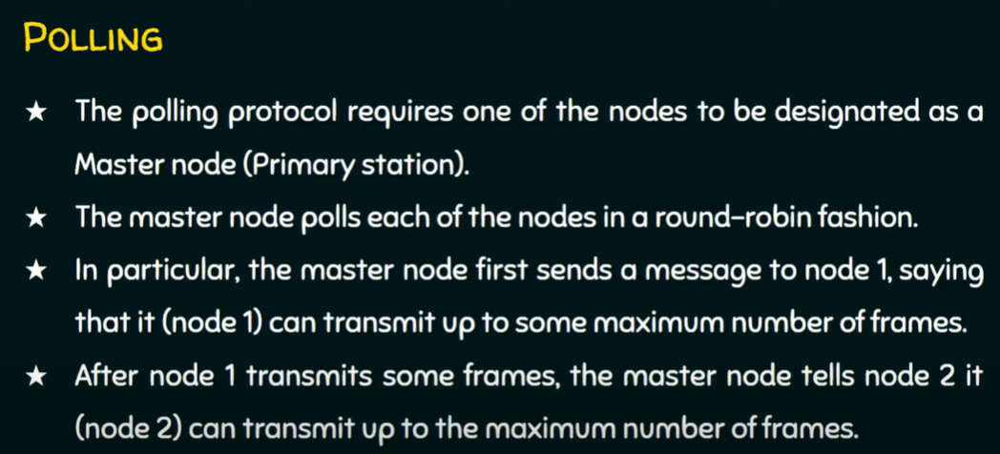

Slide 41
Channeled Access Protocols
Polling
Token passing
Reservation

Slide 42
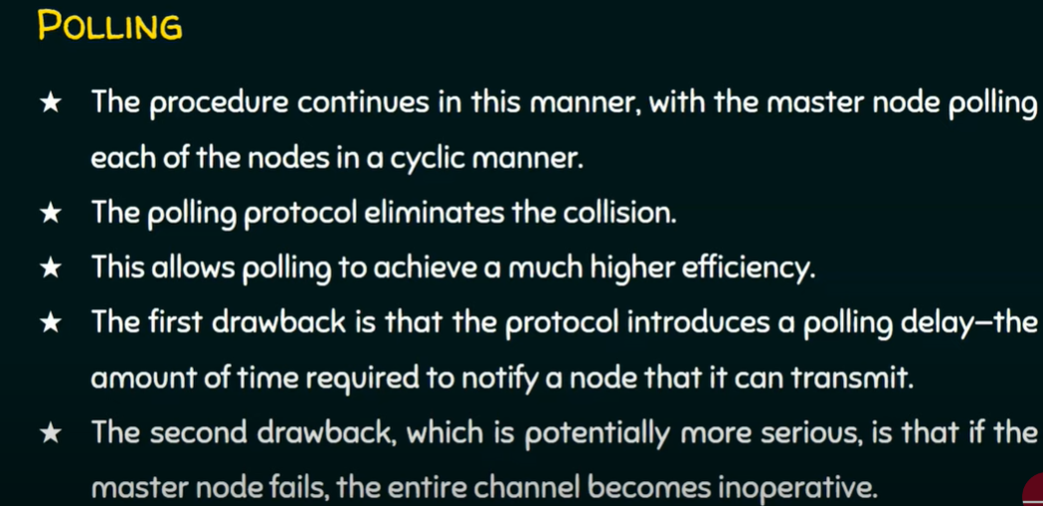

Slide 43
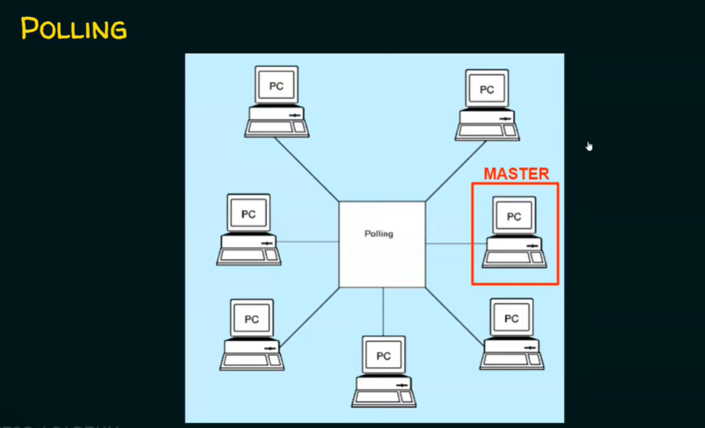

Slide 44
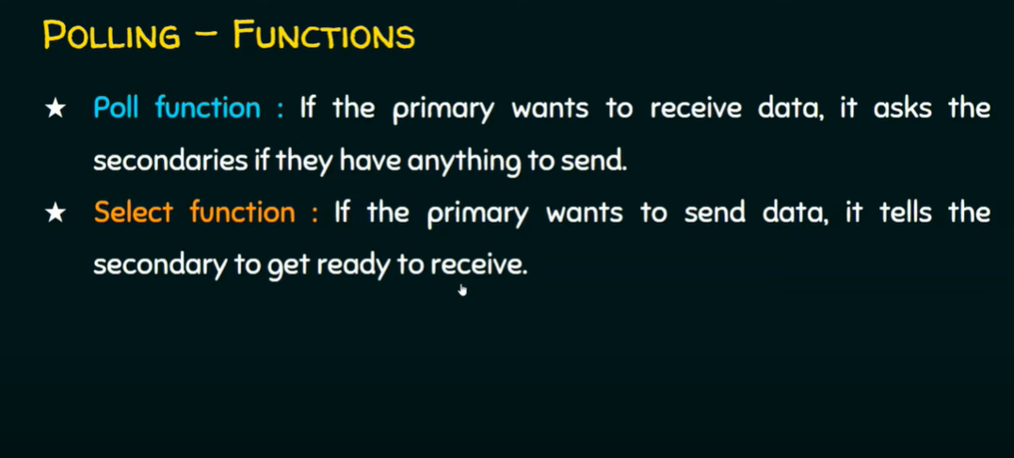

Slide 45
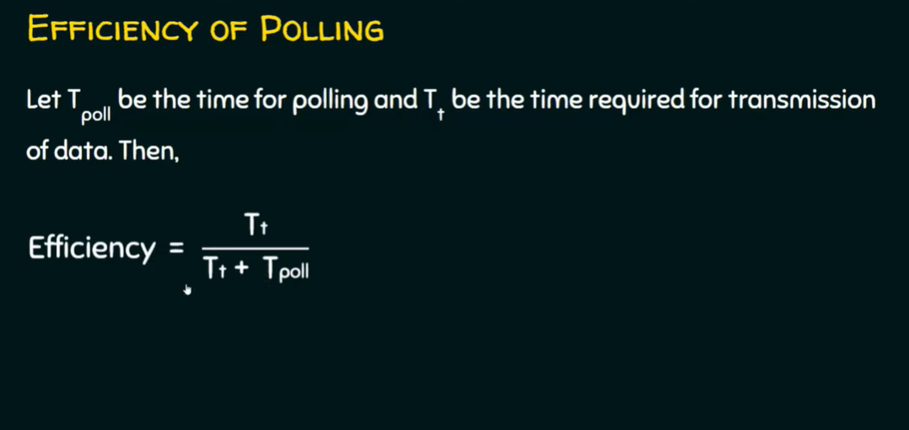

Slide 46
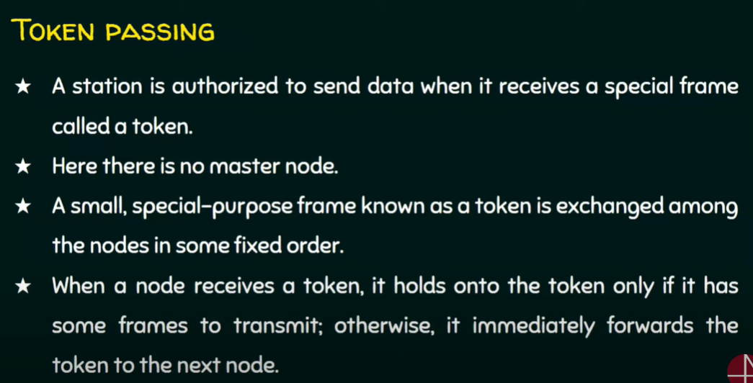

Slide 47
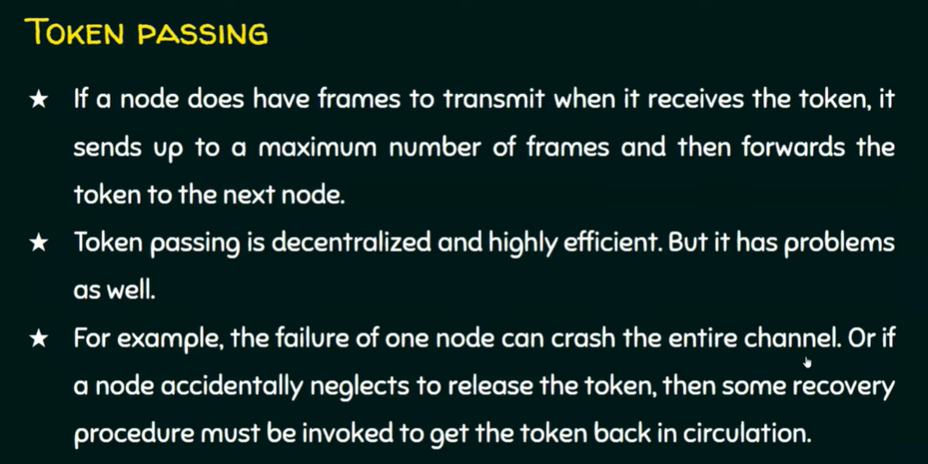

Slide 48
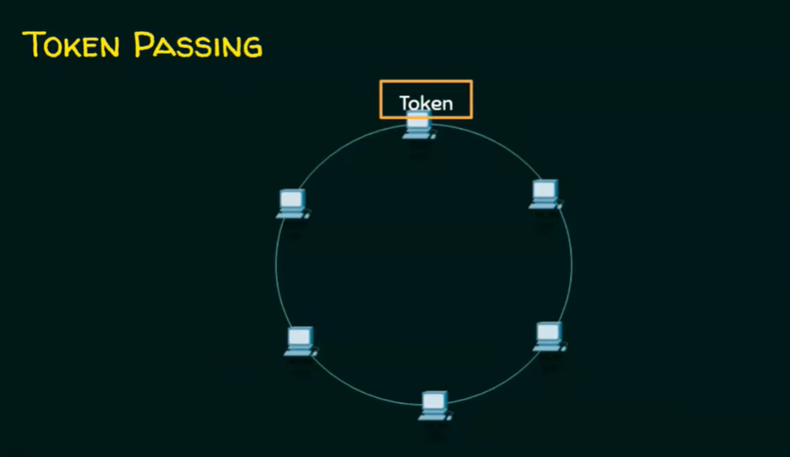

Slide 49
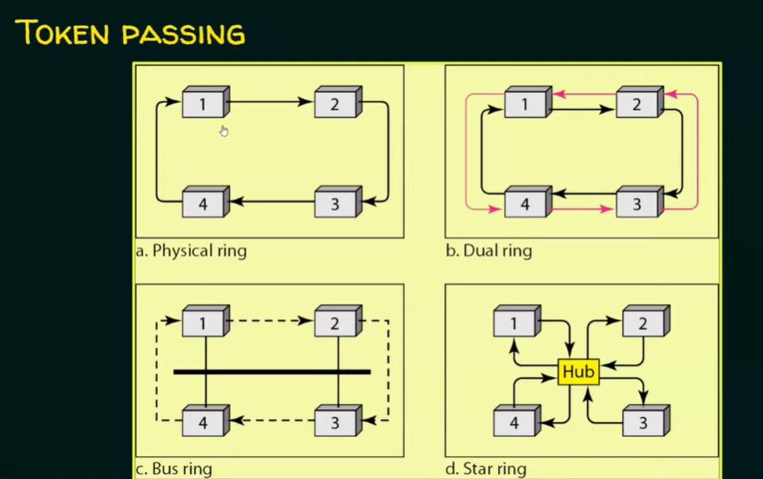

Slide 50
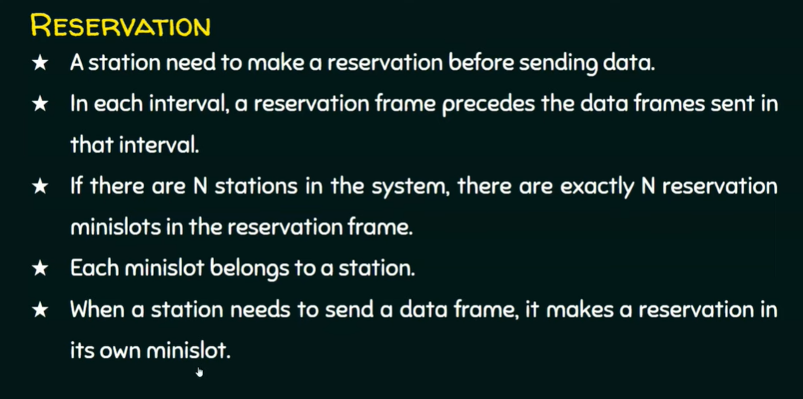

Slide 51
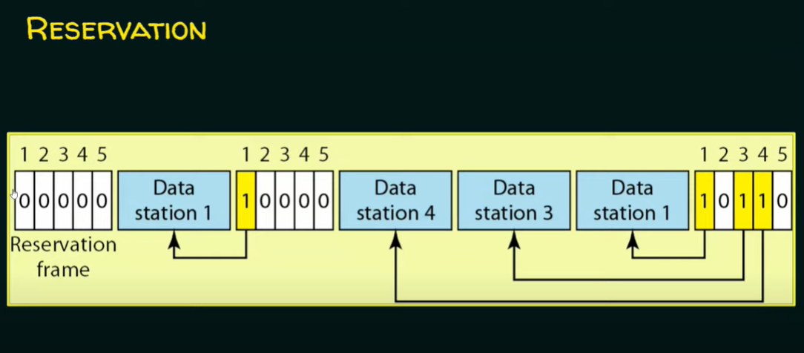

Slide 52
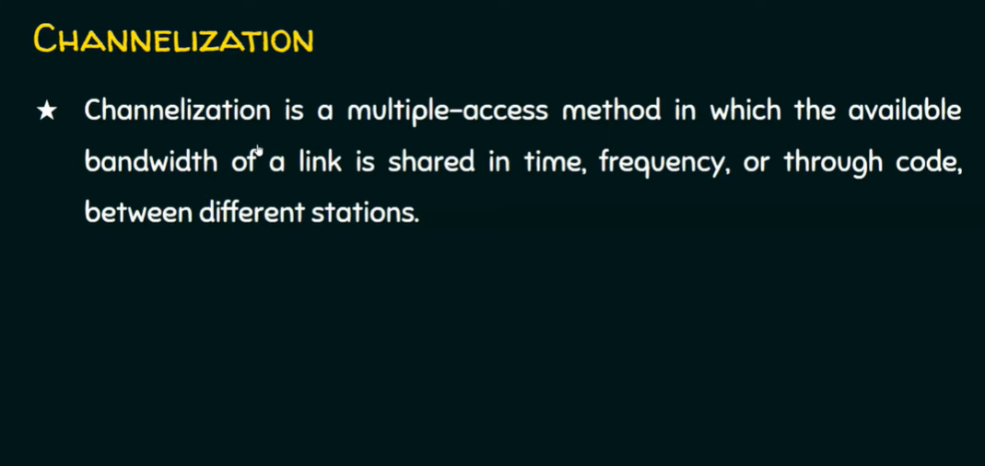

Slide 53
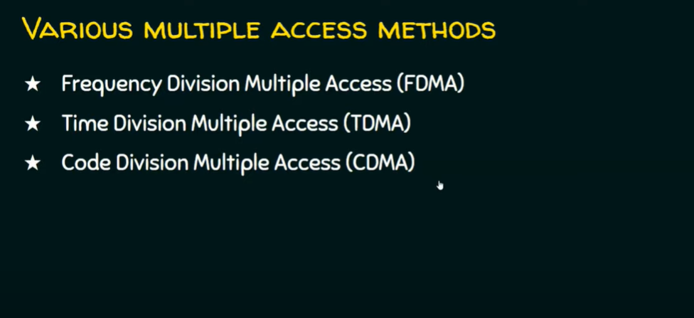

Slide 54
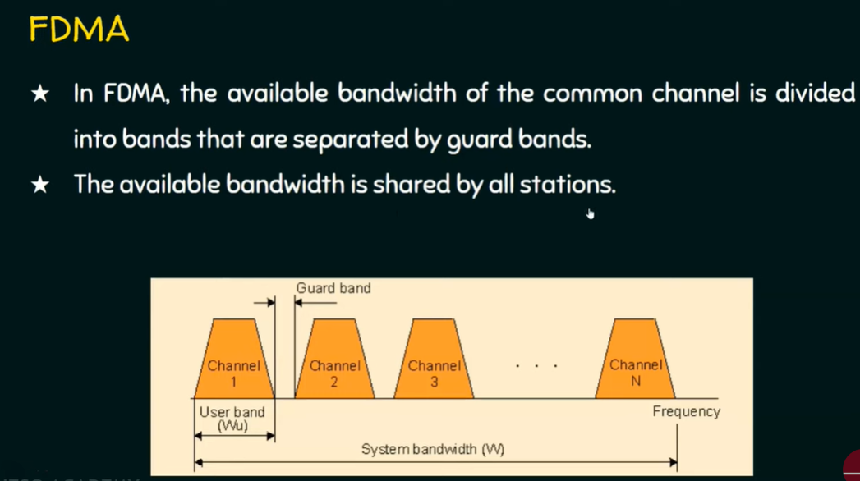

Slide 55
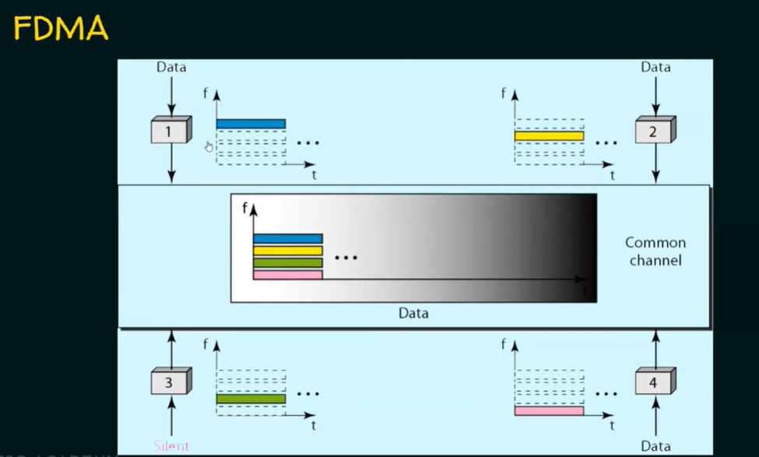

Slide 56
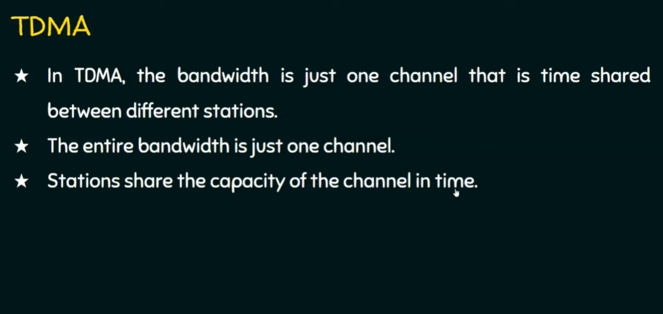

Slide 57
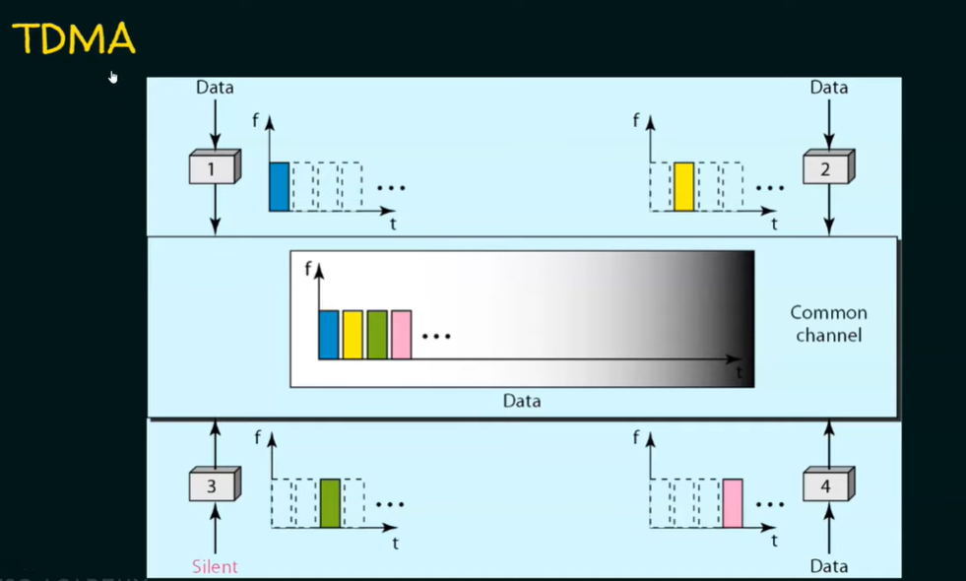

Slide 58


Slide 59

For more info: https://www.youtube.com/watch?v=YAjfUc7Tt24

